Slide 1
Recycling in Bayville

Slide 2
Bayville Environmental Conservation Commission @BECC2018 Please Like us on Facebook

Slide 3
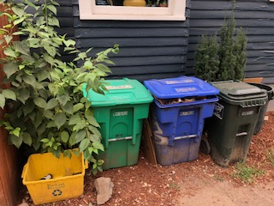
Single Stream Keeps it Simple! Single Stream Recycling is going to make us all better recyclers!
Simplicity:
Better for the Environment
Increased participation and compliance
Faster and more efficient collection
Potentially less costly for the Village and thus all of us.
Avoiding the multiple bin hassle
Over Complicated Oregon Model

Slide 4
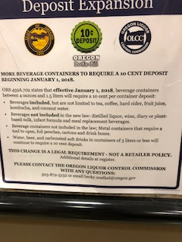
Focus on what is recyclable, not what is not.
The recycling market fluctuates: always has, always will….
The Evolution of Recycling in Bayville:
Blue Bags: Limited recyclables, separation & binding of paper required
Small Blue Bins: Added more plastic, mixed paper, separation & binding
Large Blue Pails: Added cardboard and chipboard, separation required
Single Stream: The Final Chapter! No separation or binding

Slide 5
Single-Stream Recycling Changing the way Long Island recycles!
Village of Bayville
Long Island, NY

Slide 6
Waste…there are many names for it!
Collateral
Debris
Dreck
Dross
Sewage
Pollution
Litter
Residue
Offal
Outsweeping
Rubbish
Riffraff
Swill
Scrap
Slime
Junk
Trash
Refuse
Waste
Rubble
Dregg
Filth
Excreda
Slop
Clutter
Kelter
Pelf
Tailings
Garbage
Crap
Crud
Rejectamenta

Slide 7
Garbage 101 - Talking Trash
The challenge we face
Bayville’s waste stream
When it goes “away,” where is it actually going?
Reduce, Reuse, Recycle
Improving the way we recycle

Slide 8
How much waste is out there?
4.5 pound per person per day
330,000,000 people in the U.S.
1,485,000,000 pounds per day
365 days per year
542,025,000,000 pounds per year
271,012,500 tons per year

Slide 9
How much material we produce in the Village of Bayville:
Approximately 6,800 people
5,500 tons per year of MSW
Trash
Bulk waste
Recyclables
Metal (white goods)
Yard waste
E-waste

Slide 10
Throw it “away.”

Slide 11
“AWAY” is a complex process
Generation
Home
Choice
Reuse
Toss
Collection
Pick up of garbage
School
Work
Restaurants
Etc…
Return
Recycle
Transfer
MSW Transfer Station
Recycling Center
AWAY
Incineration (Ash to a Landfill)
Disposal in a landfill
Pick up of recyclables
Pick up of Bulk waste
Pick up of Yard Waste
Used as a raw material for remanufacturing (commodity costs or sale)
Transportation
Haul it to AWAY
Ship it to MFG

Slide 12
“AWAY” is a complex process
Generation
Home
Choice
Reuse
Toss
Collection
Pick up of garbage
School
Work
Restaurants
Etc…
Return
Recycle
Transfer
MSW Transfer Station
Recycling Center
AWAY
Incineration (Ash to a Landfill)
Disposal in a landfill
Pick up of recyclables
Pick up of Bulk waste
Pick up of Yard Waste
Used as a raw material for remanufacturing (commodity costs or sale)
Transportation
Haul it to AWAY
Ship it to MFG

Slide 13
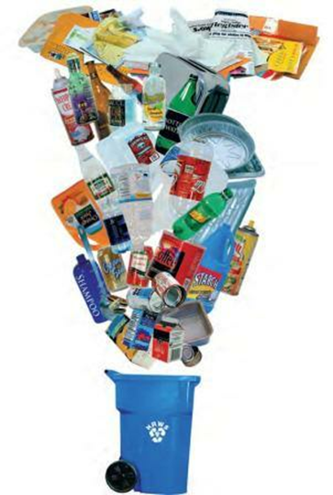
Recycling
Recycling refers to a system in which all residential recyclables are placed into a single recycling container and the material is collected and delivered to a recycling center where it is sorted for recycling.
Single stream recycling is easy – residents simply place all their recyclables into one container for collection.
At the recycling center, the recyclables are segregated by commodity type such as newspaper, cardboard, plastic, tin, aluminum, etc...

Slide 14
Motivating Factors to Switch to Single Stream Recycling
The major reasons for switching to single stream recycling are cost savings for municipalities and a desire to increase recycling rates. Motivating factors include:
Easy recycling -- all recyclable materials are placed in one container, making participation and collection easy and convenient.
Reduced collection costs -- Single-compartment collection vehicles are used which are less expensive to purchase and operate. These trucks also allow for larger loads and fewer trips to the recycling center resulting in fewer miles driven (compared to two-compartment trucks).
Increased cleanliness -- Lids and covers should be used to stop blowing litter and keep recyclables dry.
Cost avoidance/savings – Increased recycling results in less trash being sent to the landfill or waste-to-energy facility. Less waste means lower disposal costs for the municipality.

Slide 15
Technical Study
In 2010, Solid Waste Association of North America (SWANA) issued a detailed technical assistance study to compare the changes in recycling due to the implementation of a single stream collection system to replace the current dual stream system. The study sited the following results:
In Cheltenham County, Pennsylvania, Penn Waste, the area’s residential waste and recycling company reported that residential customers who transitioned to single stream realized a 25% to 30% increase in recycling.
City of Madison, Wisconsin realized a 29% increase in recycling by implementing single stream recycling.
City of Philadelphia realized a 25% to 30% increase in recycling by implementing single stream recycling.

Slide 16
SWANA Technical Study
Impacts of implementation of single stream recycling:
Increased recyclable tonnages
Increased value of recyclable commodities due to enhanced sorting capacity and capabilities
Cost savings through avoided disposal costs – when recycling or reuse replaces material disposal and subsequent costs for waste collection, transportation and gate rate tip fees at a disposal facility

Slide 17
City of Glen Cove
The City of Glen Cove implemented Single Stream Recycling in July 2015.
First year results:
Recycling rates increased by 20+ percent.

Slide 18
What’s needed to successfully recycle?
EDUCATION
Traditional
New media (social media)
On-going
Instructional
Simple
Consistent
Outreach to multiple audiences (residents, haulers/carters, elected officials, etc…)

Slide 19
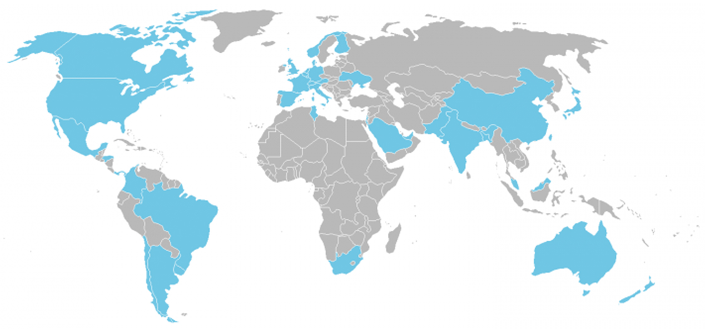
Let’s make recycling better in Bayville…
Goal of Recycling:
Reduce the amount of solid waste that gets thrown away
Encourage sustainability
Develop an economically viable solution for Bayville and Long Island.
www.isri.org

Slide 20
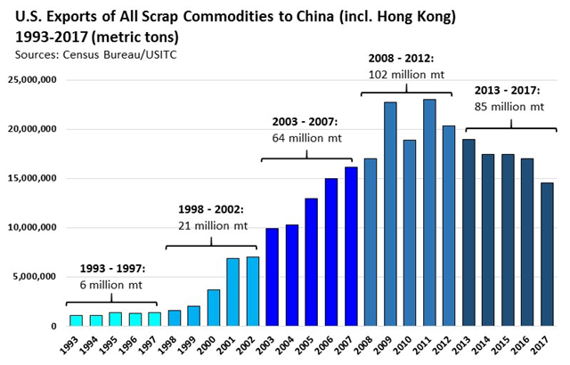
25 Year Snapshot of U.S.-China Scrap Trade Relationship
US-China scrap trade developed over last 25 years as China industrialized & needed scrap to feed its growing manufacturing economy; same period of growth as curbside programs in US that developed to meet the grade needs of its largest customer - China
www.isri.org

Slide 21
Understanding what happened in China
800 million metric tons Total Global Consumption of Scrap Commodities
180 million metric tons Total Global trade in Scrap
The U.S. - and China - are key players in the global scrap market
37 million metric tons Total scrap exports from U.S. to 155 countries
BUT China largest customer by far (>30%)
43 million metric tons Total imports into China from the World
Plastics | -92% | Paper | -38% | Aluminum | -20%
Copper | -38% | Ferrous | -5% | TOTAL | -38%
Year-over-Year declines in exports to China from the US (1st 6 mos of 2018 vs. 2017)
www.isri.org

Slide 22
Pressures Placed on U.S. Recycling Industry Over Last 12 Months
7/27/17: Chinese State Council Policy Statement
Exposes Domestic Challenges
July 2017: China Ban on post-consumer 24 categories [mixed paper; residential plastics; eff. 1/1/18]
Processing equipment/infrastructure designed to produce grades for which there is no longer demand
August 2017: China proposes “carried waste” stds on ALL scrap at levels far below global stds
Brands want their products deemed recyclable & able to go through the residential recycling stream
March 2018: final carried waste stds take effect; remain below global stds
Long term contracts without flexibility to address current conditions
April 18: China announces bans on post-industrial scrap & category 7 metals by Dec 2018; SS scrap & nonferrous scrap (ex Al & Cu) by end 2019
U.S. Recycling Industry
Time needed to create demand within the U.S.
Recycling equipment mfg report sharply improved equipment orders; therefore sig. delivery delays
May 3rd: Suspension of CCICNA for one month; complete halt of scrap exports to China through June 3rd
Wishcycling
Public confusion
What can go in the bin? What can’t?
June 16th: China announces intention to ban “solid waste” imports by 2020
Enforcement varies from community to community
Lack of consistent messaging; uniform labeling
US-China Trade War
China imposes 25% tariff on Al scrap; US imposes 25% tariff on Shredder Castings Imported from China; China announces tariffs on ALL scrap from U.S. eff. Aug 23rd
Prices for certain banned commodities (e.g., mixed paper) have plummeted, forcing review of municipal recycling programs
Freight costs/driver shortages
Spring/Summer 2018: Other Intl Markets
Spring/Summer: Infrastructure/capacity shortfalls in Southeast Asian countries trigger restrictions into Vietnam, Thailand, Malaysia & Indonesia
August 2018: US announces doubling its import tariffs on Turkish steel (50%) & Al (20%) at time of heightened Turkish market volatility
www.isri.org

Slide 23
We need to make recycling better in Bayville, on Long Island and throughout New York State. Cooperative, sustained efforts are critical to address these challenges Bottom Line All of us – The Village, recyclers, brand owners, industrial consumers, manufacturers and others – need to work together, to identify solutions to the ever changing stream of consumer products entering recycling, while also ensuring we meet the needs of the industrial consumer, at the end of the chain, to ensure a quality commodity product.

Slide 24
What residents can do:
Recycle right
Only place the listed items in your recycling container
Keep recyclables dry

Slide 25
Inside a modern Recycling Center

Slide 26
Paper after separation.

Slide 27
Sorting Process

Slide 28
Newspaper production

Slide 29
Optical sorting machine

